Slide 1
RECENT TECHNOLOGIES
USING RASPBERRY PI
BY SIVANE

Slide 2
INTRODUCTION
>RECENT TECHNOLOGY: Raspberry pi home security system with pi cam.
>By sending live stream to IP address.
> you can monitor it via any device any browser but with same connection as Raspberry pi.

Slide 3
COMPONENTS REQUIRED:
>RASPBERRY PI 4
>PI CAM V2.1
>PYTHON IDE
>DEVICE TO VIEW LIVE STREAM

Slide 4
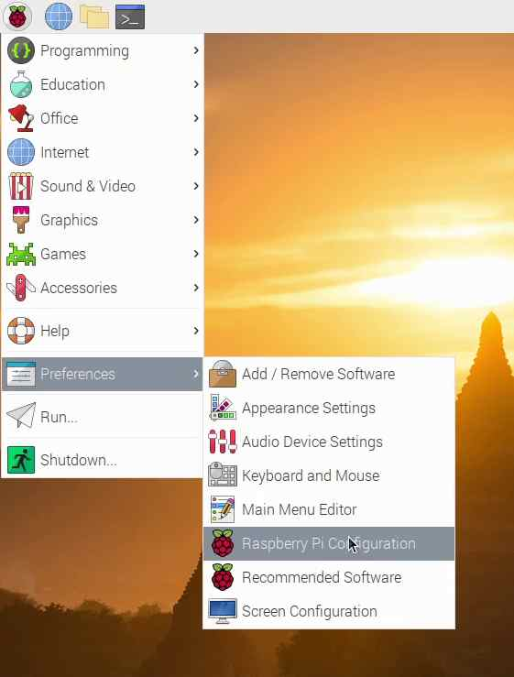
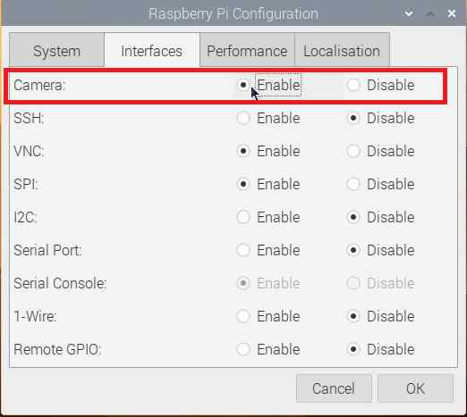
1ST STEP: ENABLE CAMERA OF RASPBERRY PI
MENU>

Slide 5
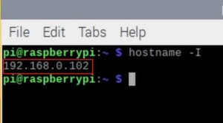
2ND STEP:FIND IP ADDRESS
OPEN TERMINAL AND TYPE hostname-I

Slide 6
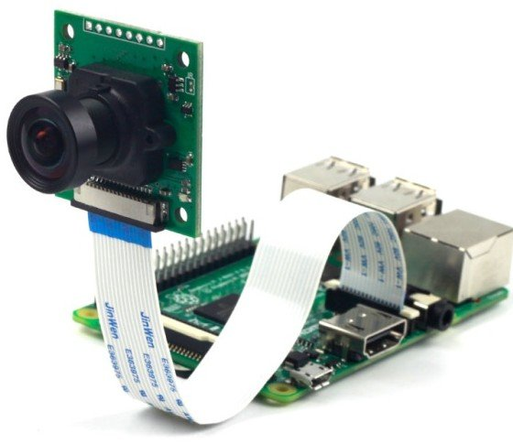
CONNECTION OF PI CAM TO RASPBERRY PI

Slide 7
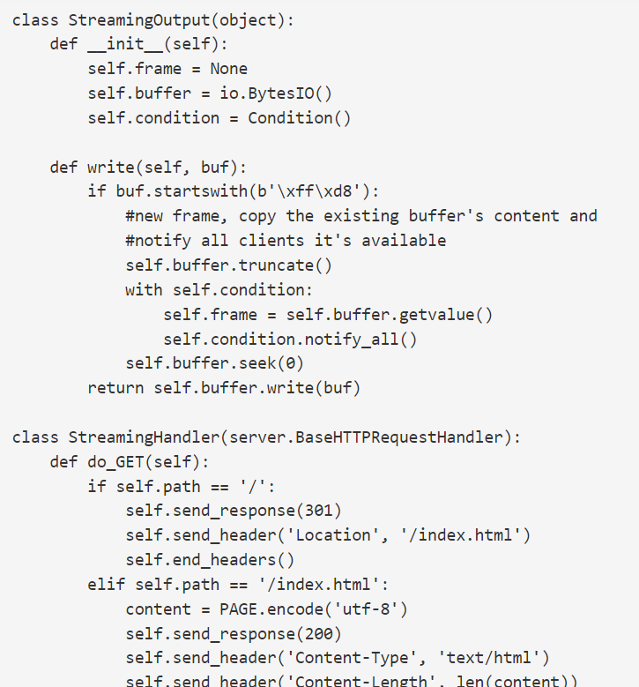
CODE:

Slide 8
REFERENCES:
https://www.youtube.com/watch?v=xDuPtLlRPGw
https://roboticadiy.com/raspberry-pi-home-security-system-project-stream-live-video/
https://www.engineersgarage.com/raspberry-pi-based-smart-home-security-system/

Slide 9
THANK YOU

